Slide 1
From Clinical Encounters to an App:
How Migori County COs Co-Created Kintaraa - A Digital Lifeline for GBV Survivors
Stella Oiro

Slide 2

Notes:
In Kenya, forty percent of women face gender-based violence. Ninety-two percent of reported cases are female victims. But these numbers only show the tip of an invisible crisis. One in three cases go unreported due to fear, stigma, and systems that weren't built for survivors.

Slide 3

Notes:
In Kenya, forty percent of women face gender-based violence. Ninety-two percent of reported cases are female victims. But these numbers only show the tip of an invisible crisis. One in three cases go unreported due to fear, stigma, and systems that weren't built for survivors.

Slide 4

Notes:
As Clinical Officers, we see them. We see survivors who come in with physical wounds but carry invisible trauma. We see them struggle to find words for unspeakable pain. We see them leave our clinics without justice, without support, without hope. And we knew something had to change.

Slide 5

Notes:
Traditional reporting systems fail survivors at every turn. Paper forms intimidate those who struggle with literacy. Police stations frighten those who fear their abusers have connections. Privacy feels impossible in small communities. The very systems meant to protect survivors often become their biggest barriers

Slide 6

Notes:
As a Clinical Officer in Migori County, I have witnessed this failure daily. Held the hands of survivors who whispered their stories but couldn't write them down. Seen them leave before completing reports. I knew survivors needed something radically different—something that understood their fear, honored their shame, and gave them control.

Slide 7

Notes:
So we did something unprecedented. We brought together Clinical Officers who understand trauma and software developers who understand technology. Healthcare workers and coders. Healers and builders. Together, this unlikely team would co-create something that had never existed before.

Slide 8
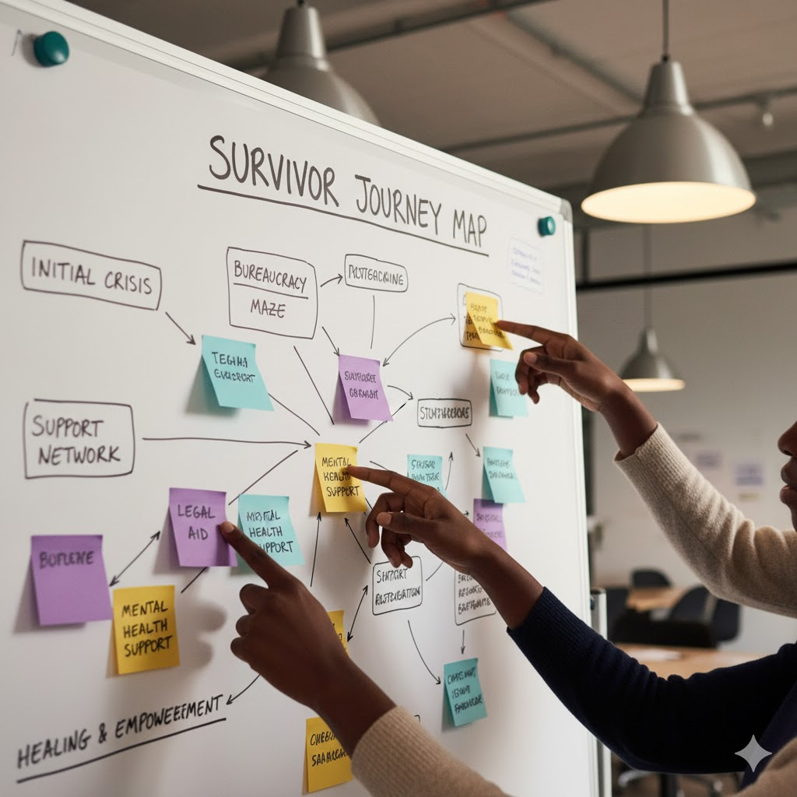
Notes:
Our question was revolutionary: What if survivors could report on their own terms? Anonymously. Securely. In their own time. From their own homes. What if technology could become a bridge of trust instead of another barrier? What if Clinical Officers could lead this innovation?

Slide 9
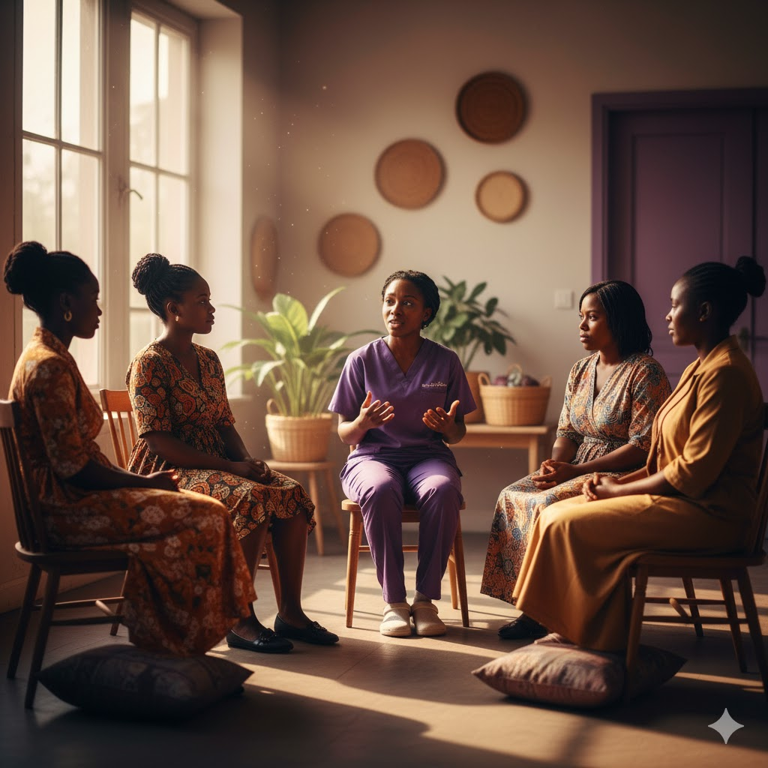
Notes:
We started by listening, deeply listening. Clinical Officers facilitated community sessions, mapping every single barrier survivors face. Fear of retaliation. Cultural shame. Distrust of institutions. Lack of transport to police stations. Economic dependency on abusers. Each barrier became a design challenge we had to solve.

Slide 10
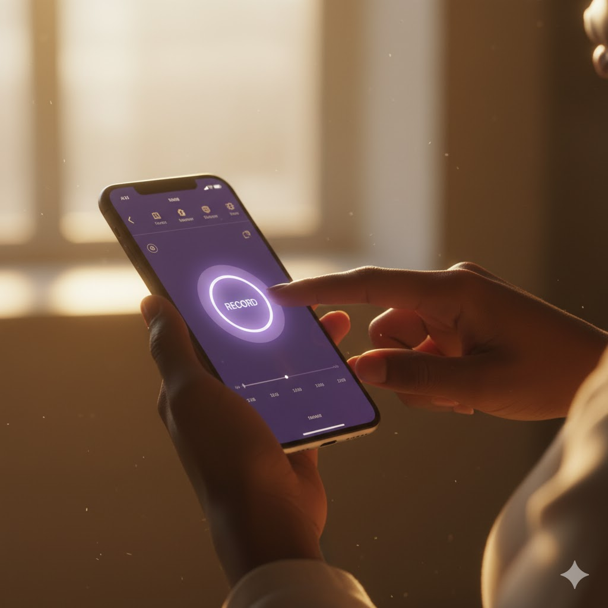
Notes:
Then came our breakthrough moment. During testing, a survivor told us: 'I cannot write my pain. My hands shake. The words won't come.' So we created voice recording capabilities. Survivors could speak their truth without typing their trauma. They could report in their mother tongue, in their own voice, on their own timeline.

Slide 11

Notes:
We integrated blockchain technology, not for buzzwords, but for something profound. Immutable, tamper-proof, anonymous reporting. Survivors can document their evidence knowing it can't be altered, and can't be erased. Technology became their witness and protector.

Slide 12

CLINICAL OFFICER
GBV SURVIVOR
POLICE OFFICER
Notes:
But we knew reporting alone wasn't enough. Survivors needed holistic care. So Kintaraa connects them instantly to counselors, medical services, legal aid, and support groups. One platform. Complete care. No survivor left to navigate a broken system alone. Every resource they need, right at their fingertips.

Slide 13
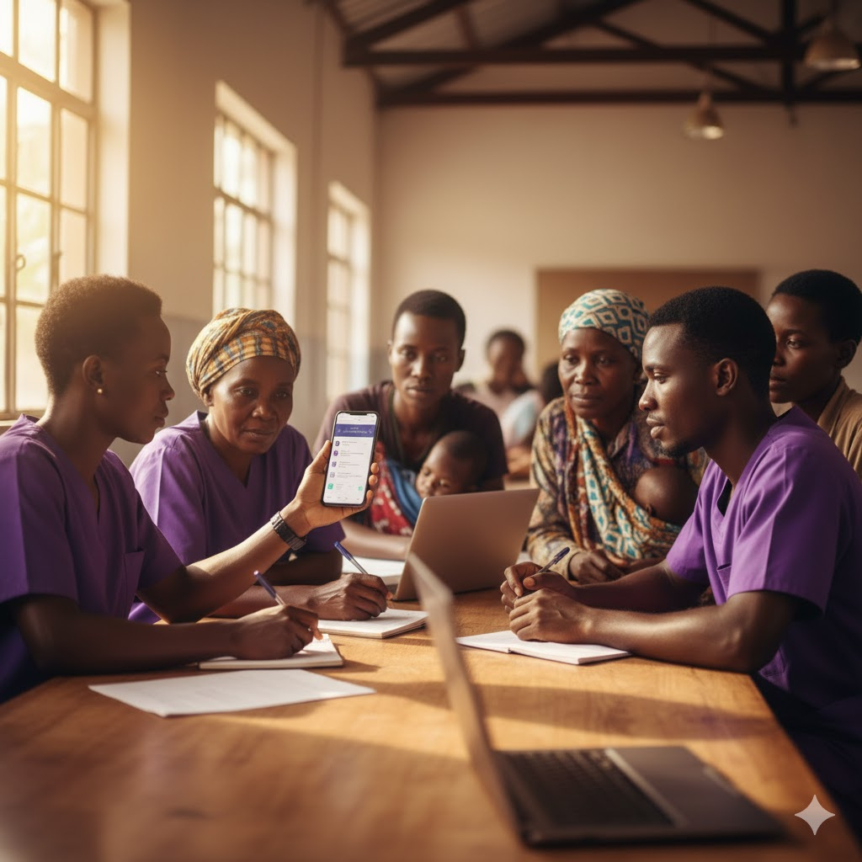
Notes:
Clinical Officers tested every single feature for cultural appropriateness. Does this language respect our communities? Will survivors from rural areas trust this design? Does it feel safe to someone who's never reported before? We refined every word, every color, every button based on real feedback from real people. We have also created a USSD code for reporting via SMS.

Slide 14
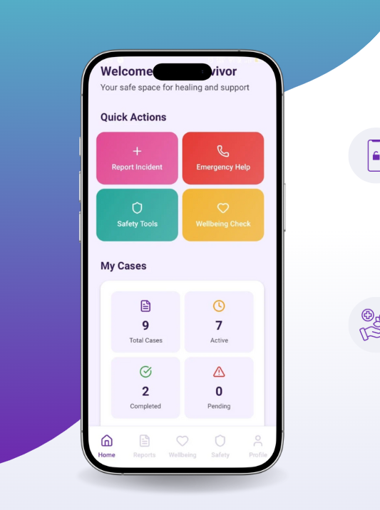
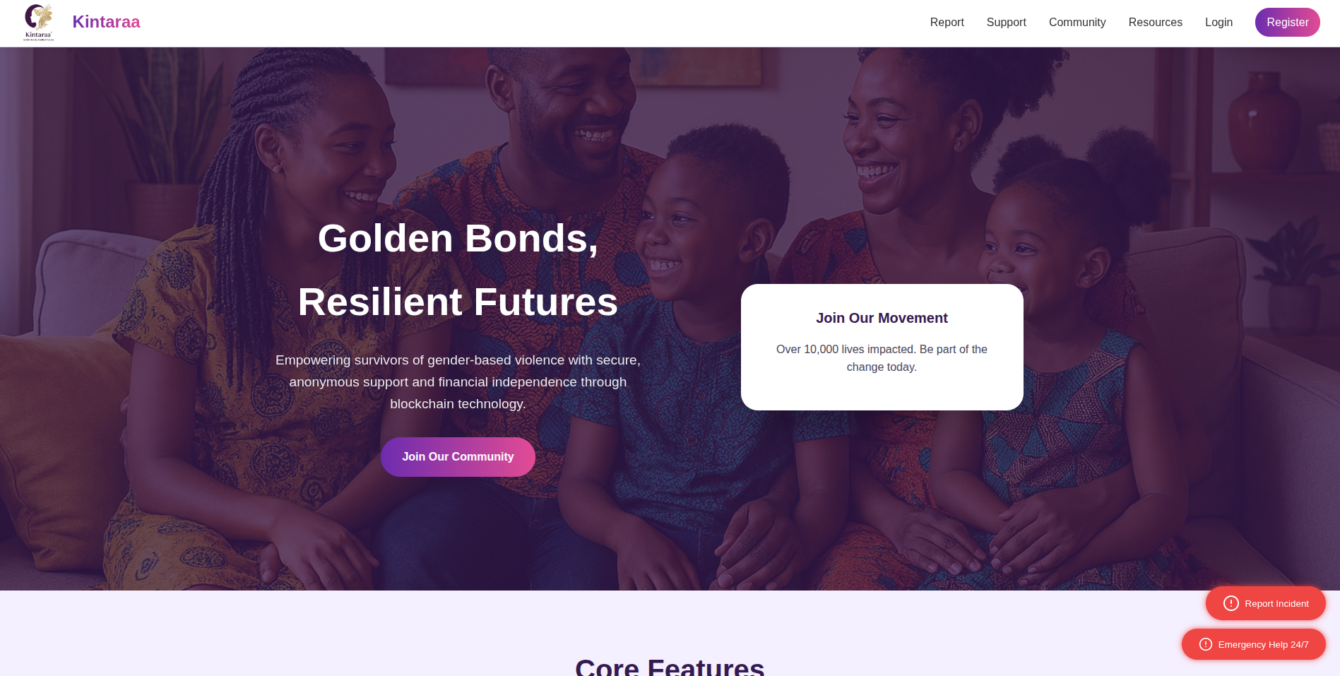
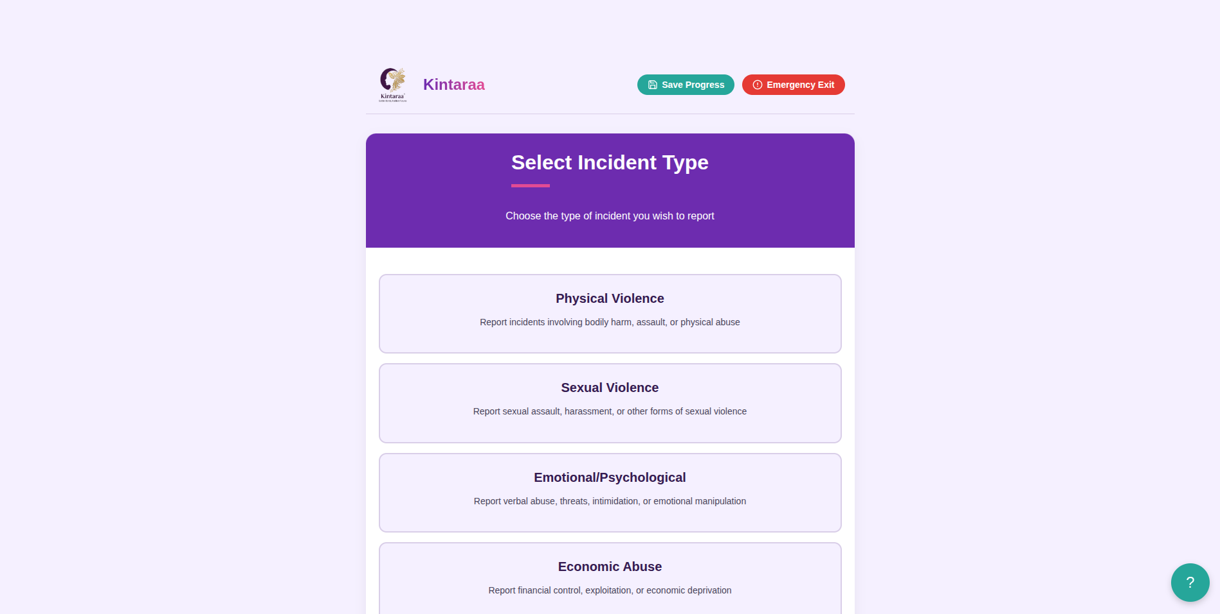
Notes:
The result: a simple, intuitive interface with quick actions for crisis moments. Report incident. Emergency help. Safety tools. Wellbeing check. Everything a survivor needs is visible immediately. Nothing overwhelming. Nothing confusing. Just clear pathways to safety and support when every second matters.

Slide 15

Notes:
Privacy isn't an afterthought, it's our foundation. End-to-end encryption protects every interaction. Survivors control their data completely. They decide what to share, when to share it, and with whom. They can delete everything with one button. Their safety. Their choice. Their power. Always.

Slide 16

Notes:
We plan to pilot Kintaraa with more clinical encounters. Clinical Officers asfirst responders, refining the platform with every survivor they serve. Each real-world test makes the system stronger, safer, more responsive.

Slide 17

Notes:
Kintaraa is proof that Clinical Officers can lead technological revolution in healthcare. We're not waiting for Silicon Valley to save us. We're not accepting top-down solutions designed by people who've never met a survivor. We're building what our communities need because we know them best.

Slide 18

Notes:
Traditional technology development is top-down. Experts in distant offices decide what communities need. We want to flip that. We centered healthcare workers as innovators, survivors as designers, and communities as decision-makers. When the people closest to the problem lead the solution, that solution actually works.

Slide 19
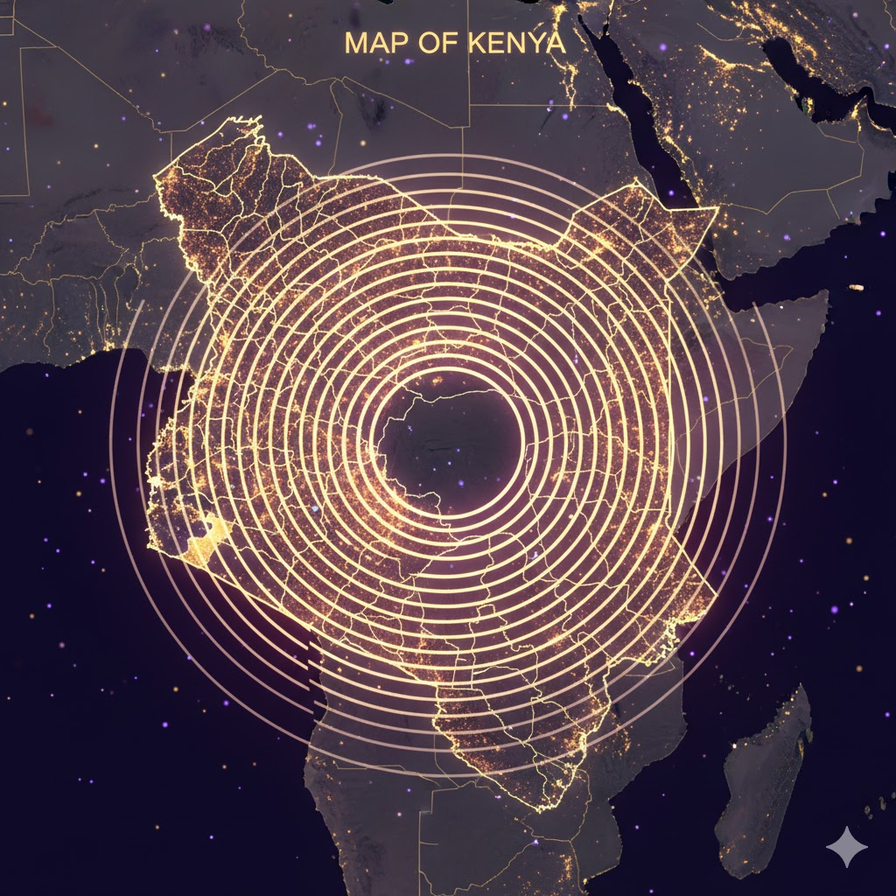
Notes:
What started in Migori County can transform how Kenya, and eventually the world, responds to gender-based violence. When frontline workers lead innovation, barriers break. When communities design their own solutions, those solutions reflect real needs. When survivors have a voice in technology, technology finally serves them.

Slide 20

Notes:
Today, Kintaraa is in final review. In January twenty twenty-six, we launch in Migori County. Our commitment: impact five thousand lives annually, mobilize two hundred volunteers, partner with fifty organizations. This platform is proof that Clinical Officers can shape the future of healthcare innovation. The movement begins now.

Slide 21

Notes:
Kintaraa proves that when Clinical Officers lead innovation, barriers break. As we prepare for launch, we invite you to witness how frontline-driven technology creates resilient futures. Join us in making gender-based violence support accessible, dignified, and survivor-centered. Golden bonds. Resilient futures. The journey begins now.

Slide 22

Thank You

